Slide 1

CircleCI Contact – 9-00-1-800-5857075

Slide 2
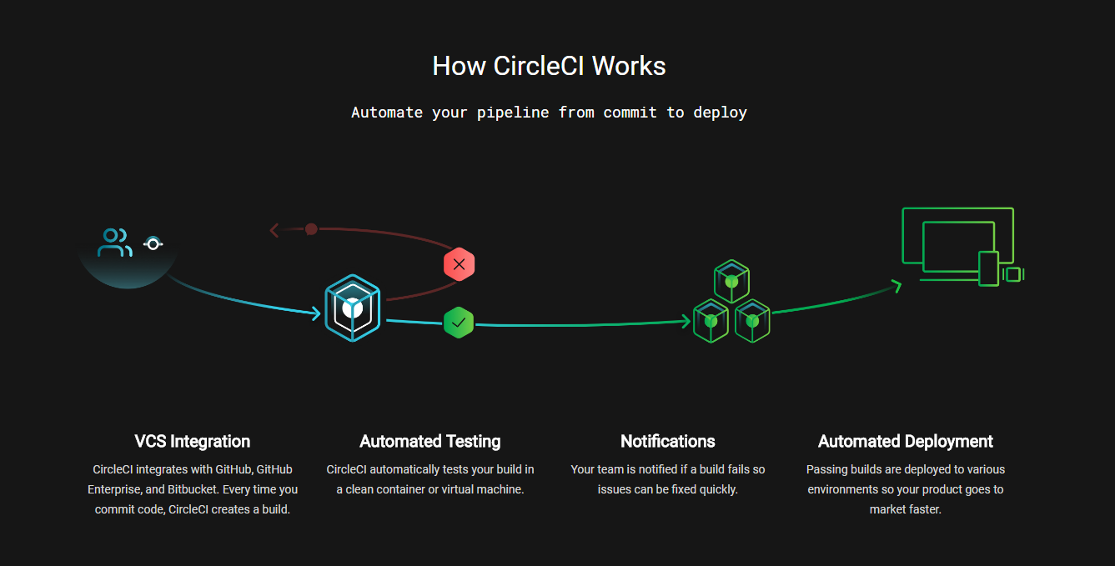

Slide 3
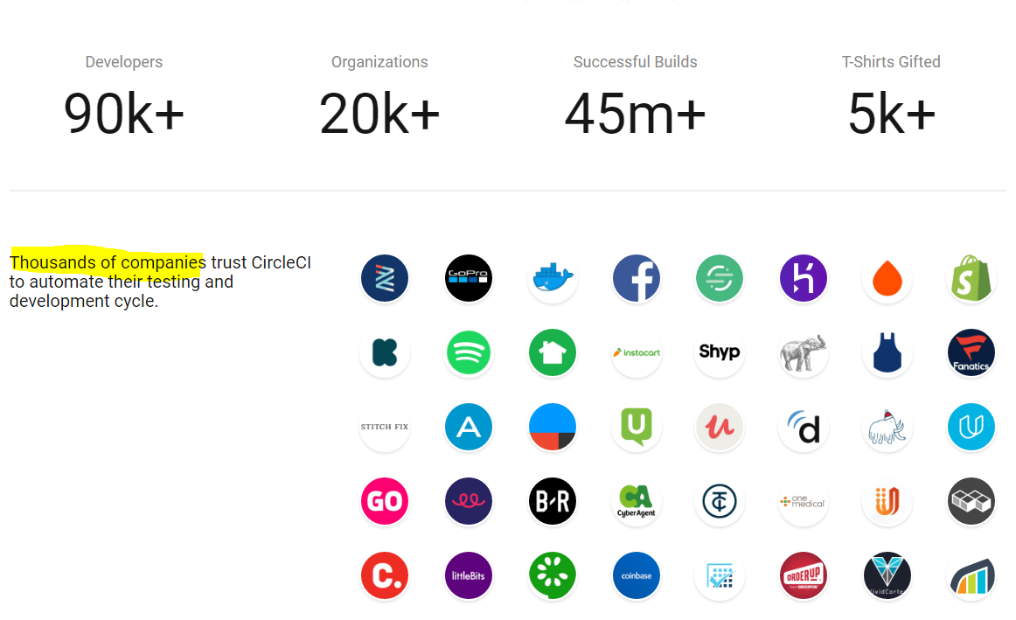

Slide 4
Language Support
Supported Languages
Clojure (v1.2.0 and later)
Elixir (v1.2 and later)
Go (v1.7 and later)
Java (Java 8 and later)
JavaScript (Node.js 4 and later) – Any NPM package: Angular2 and more..
PHP (PHP 5 and later)
Python (Python 2 and later)
React Native
Ruby and Rails (Ruby 2 and later)
Build projects in C, C#, C++, Clojure, Elixir, Erlang, Go, Groovy, Haskell, Haxe, Java, JavaScript, Node.js, Perl, PHP, Python, Ruby, Rust, Scala and many more.

Slide 5
First-Class Docker Support
Docker Hub
AWS registry
Google cloud Registry

Slide 6
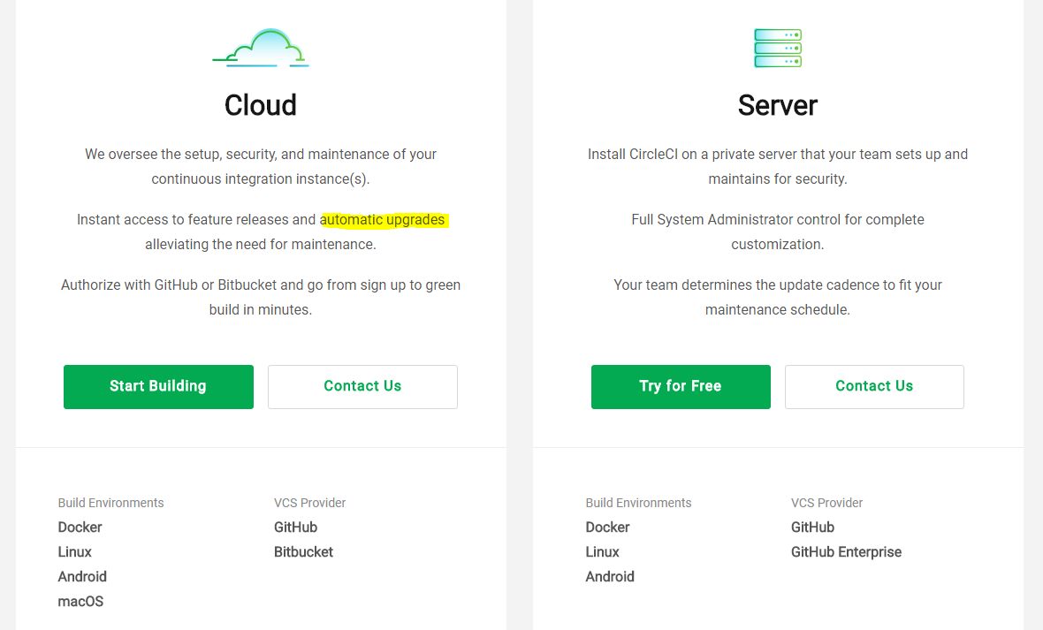
Version control systems support

Slide 7
Dependencies and image Caching
Dependencies and image Caching
SSH or Local Builds for Easy Debugging
full-level virtual machine isolation, base images designed by the end user, Docker security capabilities, Linux kernel security modules like Apparmor, and more.
Choose the CPU/RAM You Need

Slide 8
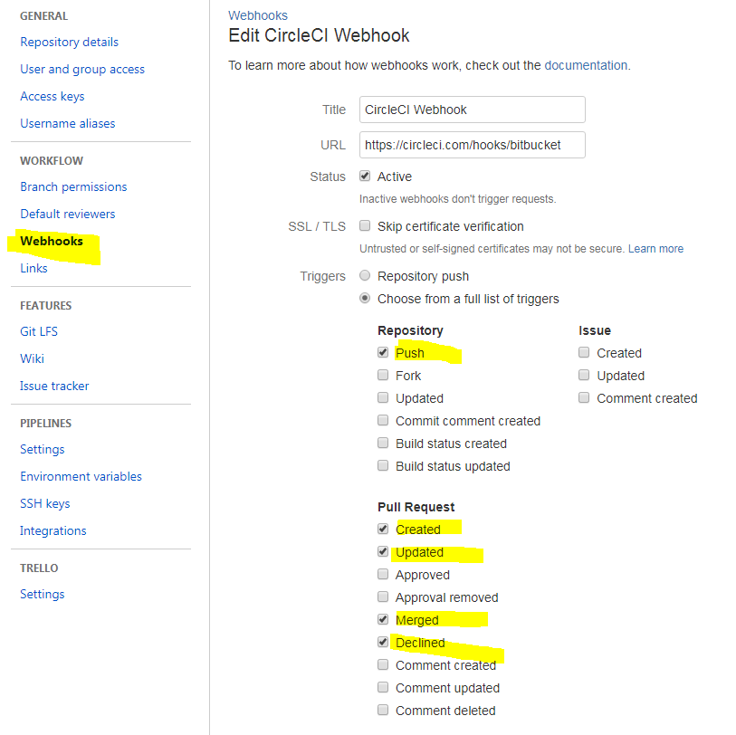
How it works

Slide 9
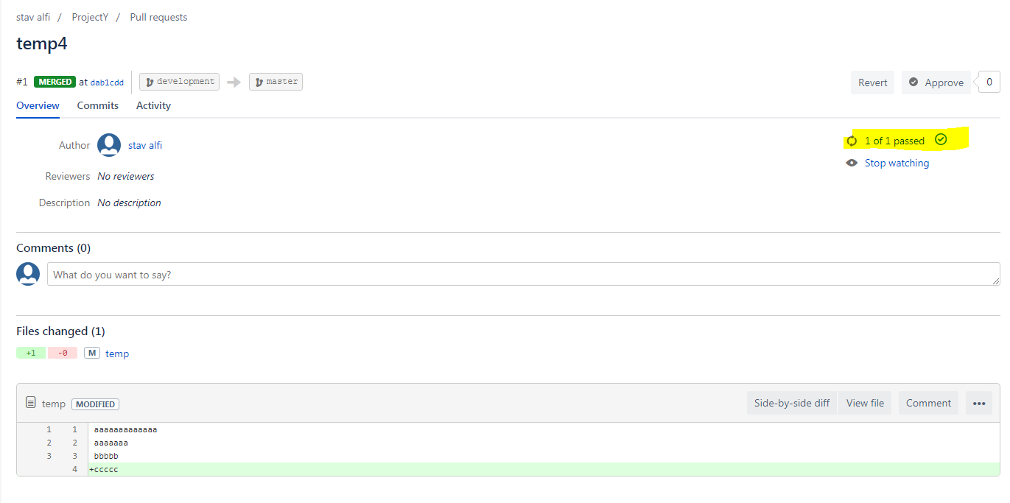

Slide 10
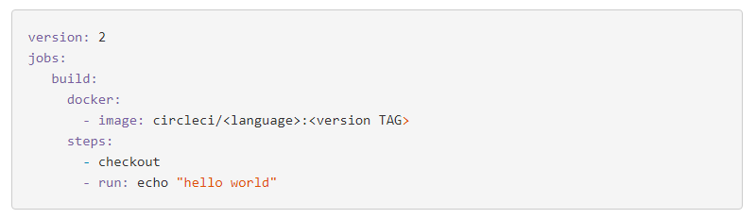
Examples:

Slide 11
 | CircleCI | Jenkins
Setup time | Quick: All in one | Slow: Unstable and lack of plugin integration QA process, Poor quality plug-ins that are difficult to combine , No native support to/from Bitbucket
Environment set up | Insolated and automatic | Manually setup and fix
Build time | Support parallel steps, Concurrent pushes | Concurrent pushes by manually configure a full machine to handle one build
Database native support | MySQL, MongoDB, Cassandra, Redis, SQLite, ElasticSearch, Neo4j, …..
2 years from today | Can be used with Github or replaced with TravisCI and more.

Slide 12


Questions…

